Slide 1

Principal Component Analysis!

Slide 2
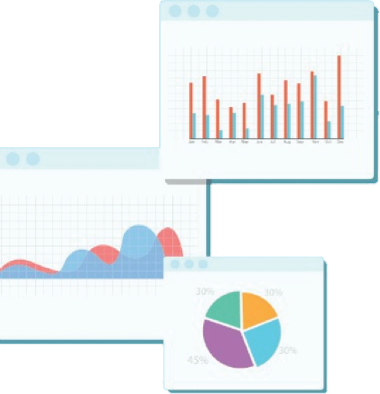


Welcome to Week 10
Lecture 2!
Data Science in Python &
Machine Learning

Slide 3
Mid Stack Survey
Please Complete!

Slide 4
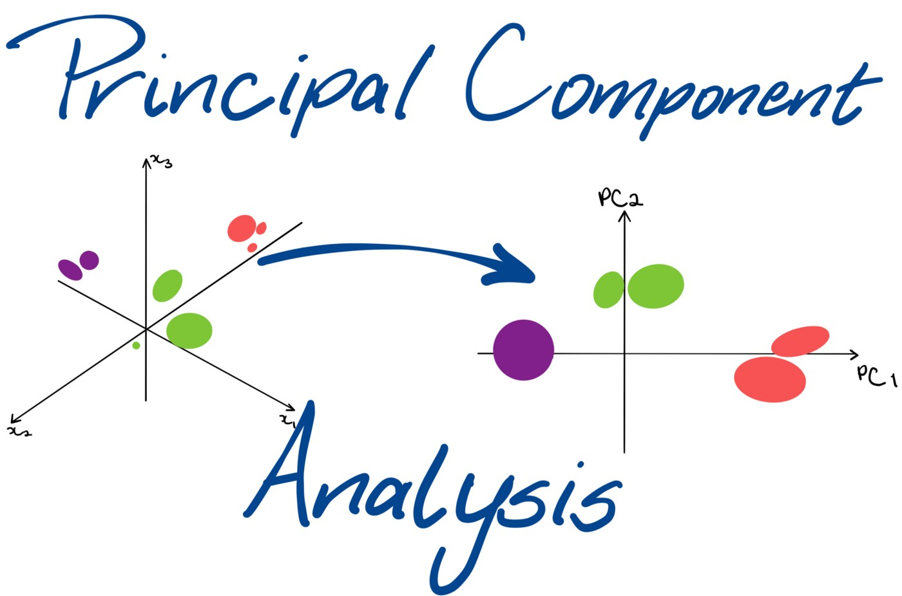
Today’s Agenda
What is dimensionality?
What is the “curse of dimensionality”?
How can we reduce dimensionality and how can we visualize it?
How can we perform PCA in Sklearn?
How many principal components should we have?
What are the pros and cons of dimensionality reduction?
How does a computer “read” images: an exploration of the MNIST digits dataset
Image courtesy of Trist’n Joseph’s blog

Slide 5
Dimensionality Reduction
Dimensions are features (columns in the dataset)
Machine learning datasets can have a huge number of features (even in the millions!)
This can slow down the training step
And leads to the “Curse of Dimensionality”
What is this curse?
ML algorithms struggle to perform well in high dimensions because the dataset tends to be very sparse making patterns hard to “find”
The more dimensions a dataset has, the higher the risk of overfitting.
Reducing the number of features does result in some information being lost, but the tradeoff can be worth it
Sometimes reducing features can even result in better model performance, but this is unusual
It can be very helpful for data viz because we can really only understand 2 (maybe 3) dimensions on a plot

Slide 6
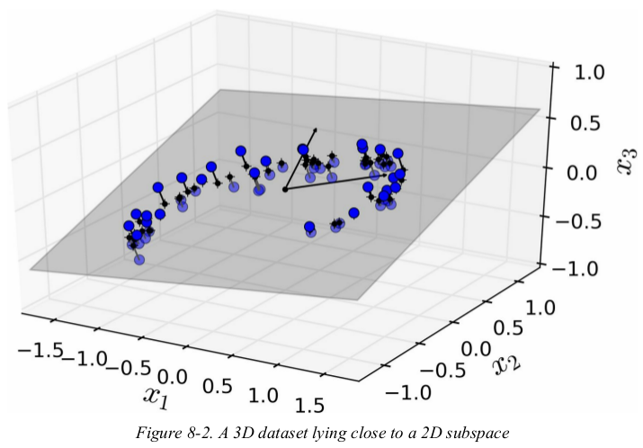
Visualizing dimensionality reduction
We are exploring dimensionality reduction beyond simply dropping columns
Example
This dataset is on a 3d plane (it has 3 features or dimensions)
Data is usually NOT spread out evenly across all dimensions
Here we see that we can capture most of the variation in our dataset by drawing a 2d plane within the 3d space
Now, we can “pull out” that 2d plane and that becomes a 2d graph!
Source: Hand-On Machine Learning with Scikit-Learn, Keras & Tensorflow by Aurelien Geron

Slide 7
How Are Principal Components Defined?
Each new component is defined as a combination of the original features, for example:
If we are reducing a dataset with 3 features, X1, X2, and X3
Into a new dataset with 2 features, Z1 and Z2,
The new features might be defined as:
Z1 = (X1 * 0.7) + (X2 * 1.3) + (X3 * -0.9)
Z2 = (X1 * 1.2) + (X2 * 1.5) + (X3 * -0.2)
For each of the 3 features of each data point in the original dataset we would use the above formulae to convert them to the 2 features of the new dataset.

Slide 8
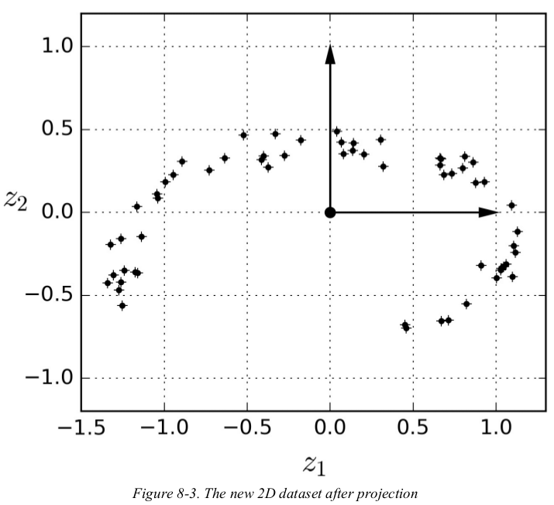
3 dimensions becomes 2 dimensions
This method is called projection.
We now have decreased from 3 to 2 dimensions.
Note: We have completely lost interpretability of the dimensions

Slide 9
Principal Component Analysis
Remember that some information is lost when reducing the dimensions
The goal is to lose as little information as possible, so we want to choose a projection that preserves as much variance as possible
PCA does this by ultimately combining our existing features into a smaller number of combined (and uninterpretable) features known as principal components
Sign_Lang_images
Iris_PCA_example

Slide 10
Summary of Pros and Cons of PCA
Pros:
It speeds up training for huge datasets
Reduces “curse of dimensionality”
It allows us to visualize lots of info on a 2d or 3d plot
Cons:
We lose some information
We can’t interpret principal components
PCA can require a lot of computation power

Slide 11

Clarifying one of this week’s datasets: MNIST Digits

Slide 12
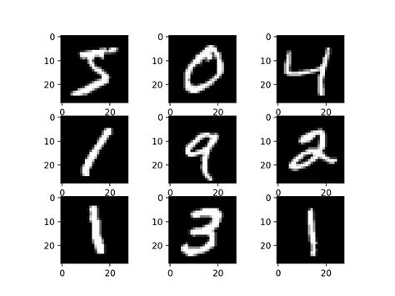
An intro to image processing: MNIST Digits
The goal is for the computer to “read” handwritten digits
This is really just a multi-class classification problem
The target (y) is a digit (0-9)
But what are the features?

Slide 13
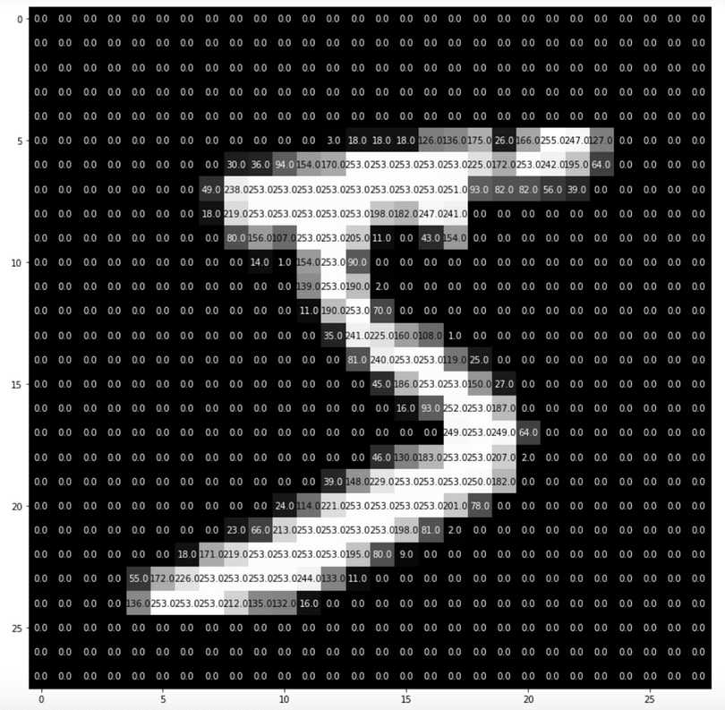
Each image consists of 28X28 pixels
Each pixel is a feature
The “data” corresponds to its color (grey scale)
0 = black
255 = white
With 784 features, you can see the need for dimensionality reduction!

Slide 14
PCA in Python
Import PCA
From sklearn.decomposition import PCA
Instantiate PCA
To return 20 components:
pca = PCA(n_components=20)
To capture 50% of variance:
pca = PCA(n_components=0.5)

Slide 15
Use PCA to transform data
Scale Data First!
X_train_scaled
Fit PCA
pca.fit(X_train_scaled)
Transform Data
X_train_processed = pca.transform(X_train_scaled)
X_test_processed = pca.transform(X_test_scaled)

Slide 16
PCA in a Pipeline
Preprocessing Pipeline
preprocessing = make_pipeline(scaler, pca)
PCA pipeline with a model
knn_pipe = make_pipeline(preprocessing, knn_model)
knn_pipe.fit(X_train, y_train)
etc.

Slide 17
Today’s Challenge
Today’s Data: Identify defects in motors
“Column 49” is the target, note that 1 is the normal condition, and the others are various types of defects
Goal: Predict the condition of the motor with the highest overall accuracy
This dataset is a great candidate for PCA because it has a lot of features
Also the prediction task is not focused on interpreting the features: We just need to identify what type of defect it is.
Note: What do think an outlier might mean for this dataset?
Challenge Notebook
Original Source of Data

Slide 18
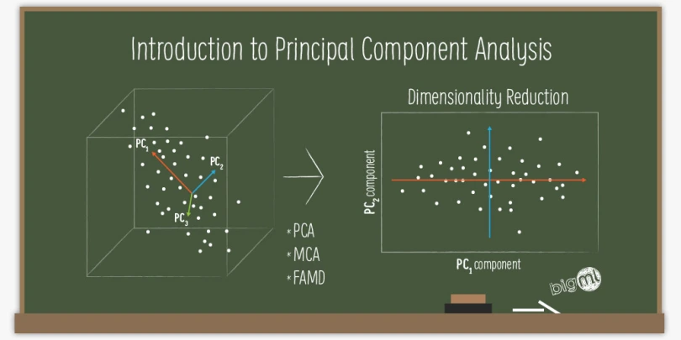
More Information:
Image thanks to atakancetinsoy’s blog
If you want to know more about PCA or get more resources on how it works or how to use it, I encourage to you follow the links below each of the images in this slide deck.
They all lead to wonderful resources to learn more.

